Slide 1
Depth of Knowledge
Melissa Thomas
Assessment and Data Response Facilitator
melissa.thomas@henry.k12.ga.us

Slide 2
Today’s Goals
Rigor in the classroom
Encouraging Teachers
Review examples
Depth of Knowledge (DOK)

Slide 3
What does rigor mean to you?
How do you define rigor?
difficult
thorough
complicated
demanding

Slide 4
What is rigor?
Academic rigor: learning in which students demonstrate a thorough, in-depth mastery of challenging tasks to develop cognitive skills through reflective thought, analysis, problem-solving, evaluation, or creativity.
Rigorous learning can occur at any school grade and in any subject!
  International Center for Leadership in Education

Slide 5
Dr. norman webb’s DOK Levels
What is the complexity of thinking required of the standard?
      Level 1: Recall/Reproduction
      Level 2: Skills and Concepts
      Level 3: Strategic Thinking
      Level 4: Extended Thinking

Slide 6
Getting to Know DOK
LEVEL 1 Recall/Reproduction (Acquire; Learn the basics) This level requires little comprehension, no complexity, and no depth. Level 1 items are much like a foundation upon which deeper knowledge can be built.
LEVEL 2 Skill/Concept (Acquire/Use; Apply the learning) At Level 2, a student interprets material and makes simple decisions about how to approach a problem. Level 2 items require more than one step and may require an explanation, an inference, conclude, compare, summarize.
LEVEL 3 Strategic Thinking (Use/Extend; Strategically think about the learning) Level 3 requires a student to analyze, evaluate, reason, and plan and to think in much deeper and complex ways. The student is expected to support his or her thinking .
LEVEL 4 Extended Thinking (Extend thinking by creating complex tasks) A student’s grasp of knowledge is deep at this level and he or she completes much deeper and complex tasks requiring the student synthesize, evaluate, and analyze.

Slide 7
DOK Level 1
Characteristics:
  Basic recall
  Either a student knows it or not
  No “figuring” or “solving” required
Activities:
  Definitions
  Labeling diagrams
  Lists
  Recitation
  Basic reproduction of steps

Slide 8
DOK Level 2
Characteristics:
  Beyond a basic description or explanation
  Application of skill in a familiar context
Activities:
  Demonstration
  Relationships
  Comparing/contrasting
  Classify/sort into categories
  Describe or explain
  Cause/effect

Slide 9
DOK Level 3
Characteristics:
  Short-term higher order thinking
  Analysis/evaluation
  Explaining the reasoning
  Real-world problems with predictable outcomes
  Original thought
Activities:
  Design a questionnaire
  Create a flow chart to show critical stages
  Solving a predictable problem
  Creating graphs/charts that require students to include/exclude information and make sense of the information given by instructor

Slide 10
Dok level 4
Characteristics:
  Synthesis
  Reflection
  Adjusting plans over time
  Real-world problems with unpredictable outcomes
Activities:
  Tasks that require change of action due to new information
  Internships
  Persuasion
  Creating graphs/charts that require students to include/exclude information and make sense of the information not given by instructor

Slide 11
Webb’s DOK = context of Verb
DOK is NOT determined by the verb, but the context in which the verb is used and the depth of thinking required.
Same verb—used at three DOK levels
DOK 1- Describe two characteristics of a simile and two characteristics of a metaphor. (Simple recall)
DOK 2- Describe the difference between a simile and the metaphor. (Requires cognitive processing to determine the differences between the two figurative devices)
DOK 3 - Describe the difference between how the poet uses the simile and the metaphor to portray the child in the poem. (Requires deep understanding of the figurative devices and an analysis of how the poet uses them)

Slide 12
Questions?

Slide 13
Webb’s Dok levels
Measures rigor and cognitive complexity
If students cannot perform at the DOK level they have not mastered the standard
Levels of DOK progress in steps; a student cannot reach a higher DOK level unless he has first mastered a lower DOK level
Provides a method to ensure the intent of the standard and the level of complexity required by that standard matches the assessment items

Slide 14
Name That DOK
 | CTAE Standard and Item | DOK Level
Standard | Demonstrate the steps of Basic Life Support (BLS) and First Aid. | ?
Item/Task | List the steps of CPR in the correct order. | ?
Adapted from CCA Reading Support Materials - Kentucky Department of Education
Notes:
Read the standard and discuss with team members the DOK level. Reach consensus.
When asked, the facilitator and/or table team members should hold up the number of fingers that reflects the DOK level selected by the table team.
Repeat the steps above for determining the DOK level for the correlating item.
Prompt groups to read the full slide before they begin discussion. Remind them that they need to assess the DOK level for both the standard and for the assessment item.
Allow groups time to discuss the two parts of the slide. This should take three to four minutes. As they begin to come to consensus, ask the recorder to hold up their choice for the parts, and then advance to the next slide. Before advancing, reassure the groups that this is a time for discussion and to get the process of analyzing the standards and assessments in mind. “Right” and “wrong” answers do not matter as much with these first few as developing an understanding of the levels and the way that the standards and items will be analyzed.

Slide 15
Name That DOK
 | CTAE Standard and Item | DOK Level
Standard | Demonstrate the steps of Basic Life Support (BLS) and First Aid. | 2
Item/Task | List the steps of CPR in the correct order. | 2
Explanation
Standard – DOK 2 This standard requires basic recall of CPR skills and asks students to demonstrate the skills. The highest level of DOK is a level 2.
Item - DOK 2. It requires the student to recall the steps of CPR, but then raises the depth by asking students to evaluate the order of the steps. By asking this question as an open response question, it raises the level to a 2 (multiple choice could have brought it to a 1). There is only one right answer.
Adapted from the GaDOE Item Bank
Notes:
Read the standard and discuss with team members the DOK level. Reach consensus.
When asked, the facilitator and/or table team members should hold up the number of fingers that reflects the DOK level selected by the table team.
Repeat the steps above for determining the DOK level for the correlating item.
Prompt groups to read the full slide before they begin discussion. Remind them that they need to assess the DOK level for both the standard and for the assessment item.
Allow groups time to discuss the two parts of the slide. This should take three to four minutes. As they begin to come to consensus, ask the recorder to hold up their choice for the parts, and then advance to the next slide. Before advancing, reassure the groups that this is a time for discussion and to get the process of analyzing the standards and assessments in mind. “Right” and “wrong” answers do not matter as much with these first few as developing an understanding of the levels and the way that the standards and items will be analyzed.

Slide 16
name that DOK
 | Social Studies Standard and Item | DOK Level
Standard | Students will identify and compare and contrast (purposes, sources of power) various forms of government in the world (e.g., monarchy, democracy, republic, dictatorship) and evaluate how effective they have been in establishing order, providing security, and accomplishing common goals. | ?
Item/Task | Create a party and party platform with three to five issues. Present and debate those issues. | ?
Adapted from CCA Social Studies Support Materials - Kentucky Department of Education
Notes:
Prompt groups to read the full slide before they begin discussion. Remind them that they need to assess the DOK level for both the standard and for the assessment item.
Allow groups time to discuss the two parts of the slide. This should take three to four minutes. As they begin to come to consensus, ask the recorder to hold up their choice for the parts, and then advance to the next slide. Before advancing, reassure the groups that this is a time for discussion and to get the process of analyzing the standards and assessments in mind. “Right” and “wrong” answers do not matter as much with these first few as developing an understanding of the levels and the way that the standards and items will be analyzed.

Slide 17
name that DOK
 | Social Studies Standard and Item | DOK Level
Standard | Students will compare and contrast (purposes, sources of power) various forms of government in the world (e.g., monarchy, democracy, republic, dictatorship) and evaluate how effective they have been in establishing order, providing security, and accomplishing common goals. | 3
Item/Task | Create a party and party platform with three to five issues. Present and debate those issues. | 4
Explanation
Standard – DOK 3 There are multiple objectives to this standard, thus there are
multiple DOK levels; however, the ceiling, or the highest DOK Level at which students can be assessed for item development, is level 3.
Item - DOK 4. It requires the student to plan and develop solutions to problems.
Adapted from CCA Social Studies Support Materials - Kentucky Department of Education

Slide 18
Name That DOK
 | ELA/Reading Standard and Item | DOK Level
Standard | Students will locate key ideas or information in a passage. | ?
Item/Task | After reading a passage, students are asked: The Sumerians chose 60 as the base for their number system because A. there are 60 minutes in an hour. B. they invented dial clocks. C. 60 can be divided easily. D. there were six sacred directions on the Sumerian compass. | ?
Adapted from CCA Reading Support Materials - Kentucky Department of Education
Notes:
Read the standard and discuss with team members the DOK level. Reach consensus.
When asked, the facilitator and/or table team members should hold up the number of fingers that reflects the DOK level selected by the table team.
Repeat the steps above for determining the DOK level for the correlating item.
Prompt groups to read the full slide before they begin discussion. Remind them that they need to assess the DOK level for both the standard and for the assessment item.
Allow groups time to discuss the two parts of the slide. This should take three to four minutes. As they begin to come to consensus, ask the recorder to hold up their choice for the parts, and then advance to the next slide. Before advancing, reassure the groups that this is a time for discussion and to get the process of analyzing the standards and assessments in mind. “Right” and “wrong” answers do not matter as much with these first few as developing an understanding of the levels and the way that the standards and items will be analyzed.

Slide 19
Name That DOK (Key)
 | ELA/Reading Standard and Item | DOK Level
Standard | Students will locate key ideas or information in a passage. | 1
Item/Task | After reading a passage, students are asked: The Sumerians chose 60 as the base for their number system because A. there are 60 minutes in an hour. B. they invented dial clocks. C. 60 can be divided easily. D. there were six sacred directions on the Sumerian compass. | 1
Explanation
Standard – DOK 1. It requires locating/recalling information.
Item - DOK 1. It requires locating/recalling information.
Adapted from CCA Reading Support Materials - Kentucky Department of Education
Notes:
Discuss briefly within your groups your ratings in comparison to the levels that Webb assigned to each of the parts of this sample.
The standard for this example is a level three. It calls for the students to analyze and/or evaluate the author’s use of persuasive techniques. This requires students to work at the strategic thinking level or complex reasoning level. They must draw on their knowledge of persuasive techniques (recall) and to be able to interpret the writing and use of those techniques. It also requires students to analyze and interpret a given passage which moves it to a level three standard.
For the assessment item, students are given a passage from the text. They must understand that by repeating the word “honorable” in his speech, Marc Antony is not being literal but is creating verbal irony. His use of honorable in this way must be interpreted from the text. This level of first recognizing the repetition as a figurative device then understanding the purpose of its use in context and finally interpreting the intent of the author shows a match between the level called for in the standard and the assessment item.
This example would represent a match between the intent of the standard and the assessment item since we want the assessment item to be written at or above that of the standard.
Let’s look at another example. Again, discuss the DOK level of both the standard and the item independently and then be prepared to share your evaluation.

Slide 20
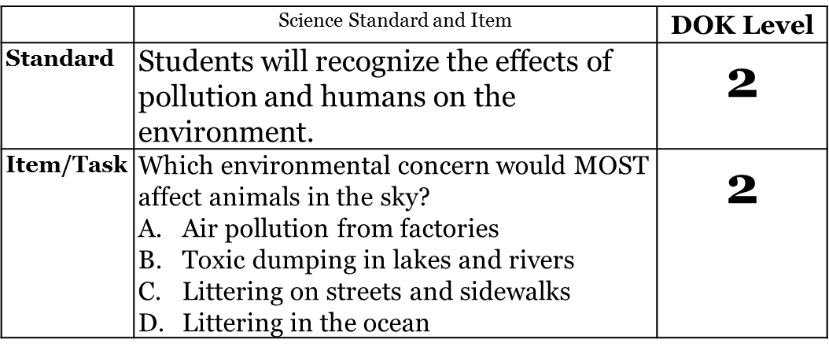
Name That DOK

Slide 21
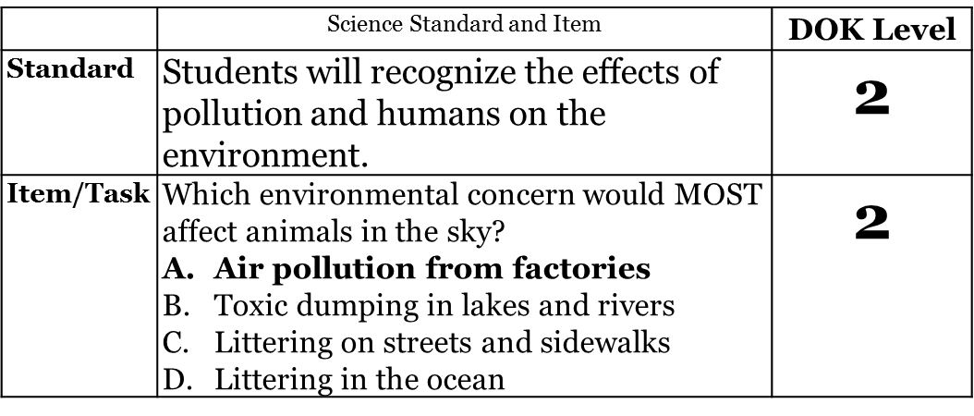
Name That DOK (Key)
Explanation
Standard – DOK 2. It requires applying a skill in a familiar context.
Item - DOK 2. The student is required to apply the information. Because the student is required to know more than the definition, this item is at a level 2.
Georgia Department of Education

Slide 22
How can we modify questions?
What does the standard require of the student?
 | Science CTAE Standard and Item | DOK Level
Standard | Students will recognize the effects of pollution and humans on the environment. | 2
Item/Task | Using your DOK question stems, how can you address this concept of the effects of pollution and humans on the environment at a level 3 or 4? Which environmental concern would MOST affect animals in the sky? | ?

Slide 23
How can we modify questions?
How is pollution related to a decrease in animal populations? (DOK 3)
Choose a population of animals and show at least 3 ways they are affected by humans. (DOK 3)
Choose a population of animals and show at least 3 ways they are affected by humans. Choose one of those ways to show how humans can decrease their impact on the animal population. Using media, create a campaign to show humans how they can decrease their impact on the animal population. (DOK 4)

Slide 24
How do we turn rigor into practice?
How do we increase rigor in the classroom?
  Become aware of the level of questioning in the classroom.
  Who is asking the questions?
    Teacher to student
    Student to Teacher
    Student to student
  Evaluate your current questioning strategies to increase the level

Slide 25
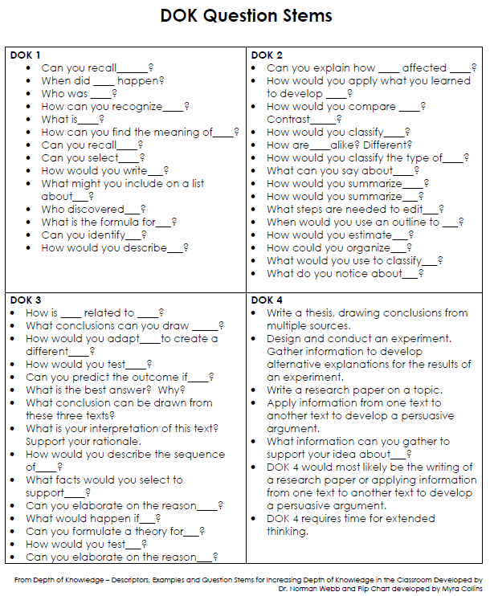

Slide 26
Encouraging teachers
1.
Determine DOK of the standards
2.
Review questioning techniques
3.
Determine the DOK of the questions to ensure they match
4.
Become purposeful in planning questions

Slide 27
Thank you!
Melissa Thomas
  Learning and Leadership
  melissa.thomas@henry.k12.ga.us
  770.957.6547
Call on me anytime!

